Slide 1

AI- iPSC Monitoring
Precision Automation for Advanced Cell Therapy

Slide 2





User Persona
Core Goals
Reliable iPSC cultures
Fewer failed batches
High data consistency
Optimized lab hours
Dr. Sarah
STEM CELL RESEARCHER
Frustrations
I spend 40% of my working time manually monitoring cells. Any missed errors could set our research back months.
contamination
Overnight failures
Missing step
Costly research delays

Slide 3










The Cost of Human Error
Where Things Break Down
Mapping the user journey and critical failure points
Delayed Detection
Monitoring Gaps:
Environmental Volatility
Incubation Disruption
Metabolic Anomalies
High Subjectivity
Audit Risk
Visual assessment is inconsistent
No digital audit trail
EMOTIONAL SATISFACTION CURVE
Seed Cells
Incubate
Manual Check
Overnight
Decision
Excitement/Start
Wait Period
Human Subjectivity
Blind Spot
Pass or Fail
CRITICAL INTERVENTION ZONES

Slide 4






















Today's Lab Process
Inefficient manual check cycles
Subjective decision-making risks
Critical overnight monitoring gaps
Seed Cells
Incubate
Manual Check
Decision
Adjust / Repeat
Initial setup
37°C Environment
High Error Risk
Subjective Data
Standard Loop
AI-Assisted Monitoring
Autonomous oversight for optimized cell culture
AI Camera
Capture
Seed Cells
Incubate
(37°C)
Analysis
Auto Alert
& Log

Slide 5
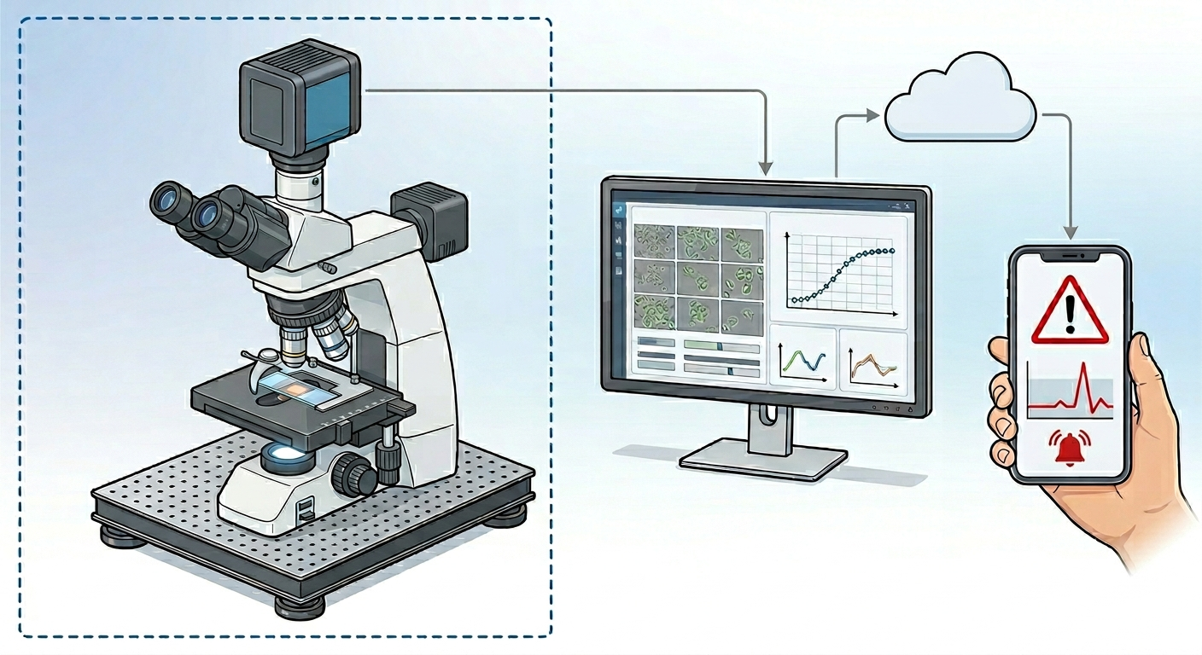

Connect the cloud (cell guard) to external mobile device for alert
Connect the visual input device to PC with cloud (cell guard system)
Connect the visual input device to the Ipscs (system)

Slide 6
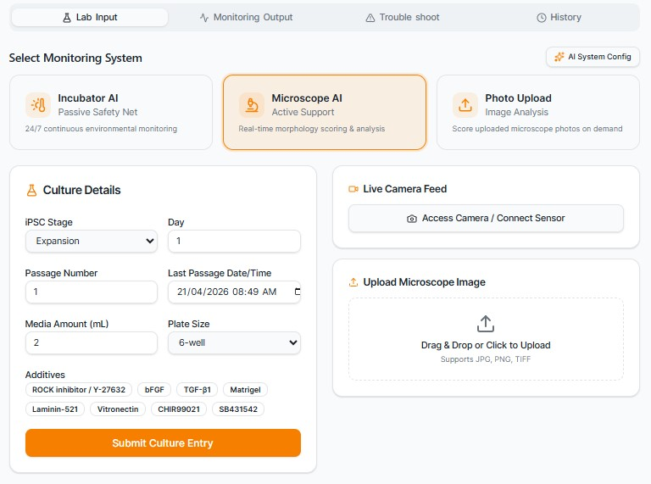
Tabs for navigation
Type of systems
Visual input
factors input

Slide 7
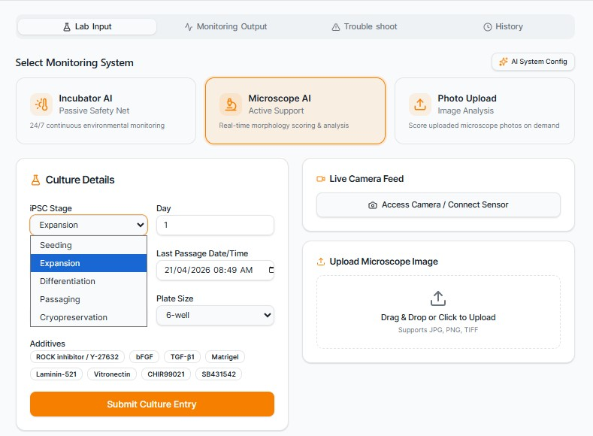
Model 2
will define the error
Days is important to track the stage quality
Every stage have different error solving mechanism
The additive is essential in some errors
After optimizing the focus and zoom on the microscope you can click for evaluation

Slide 8
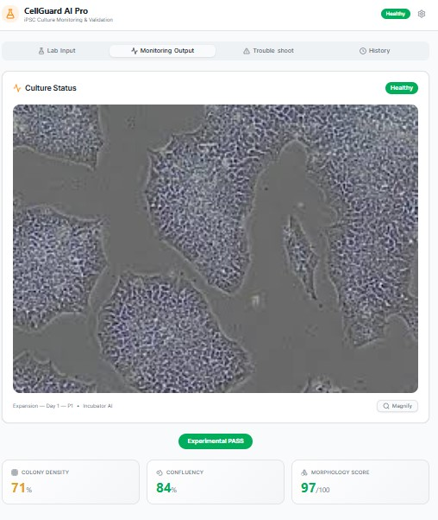
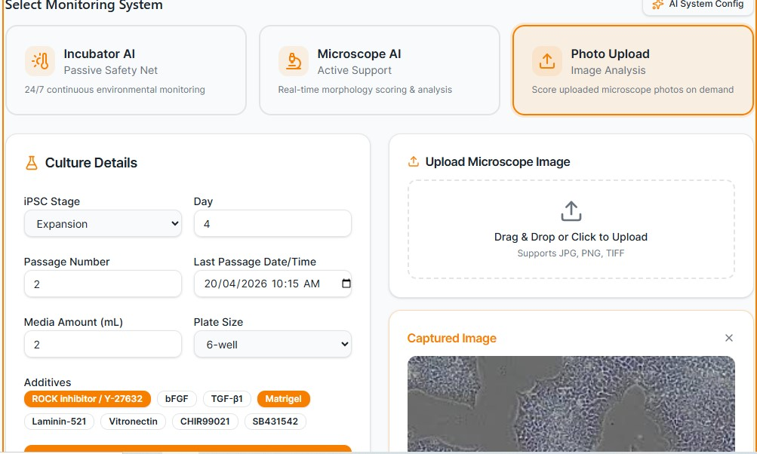
The evaluation should give you a brief status terms
Fill all necessary information
Financial Validation & ROI
Annual Savings: $125,000
Annual Cost: $7,300
1,612% First Year ROI

Slide 9
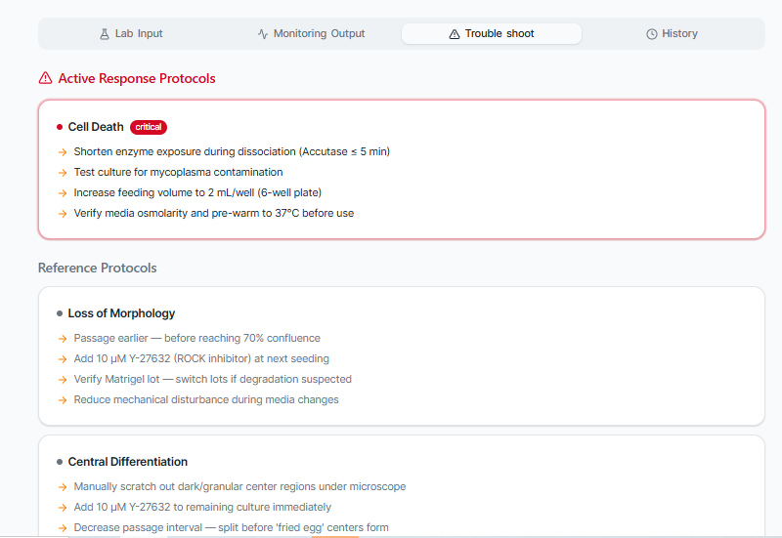
Action orientation
All monitoring, output and troubleshooting information based on labs experience and stem cell reference sources
https://www.stemcell.com/troubleshooting-tips-for-hpsc-culture.html
https:///ipsc-maintenance-challenges

Slide 10
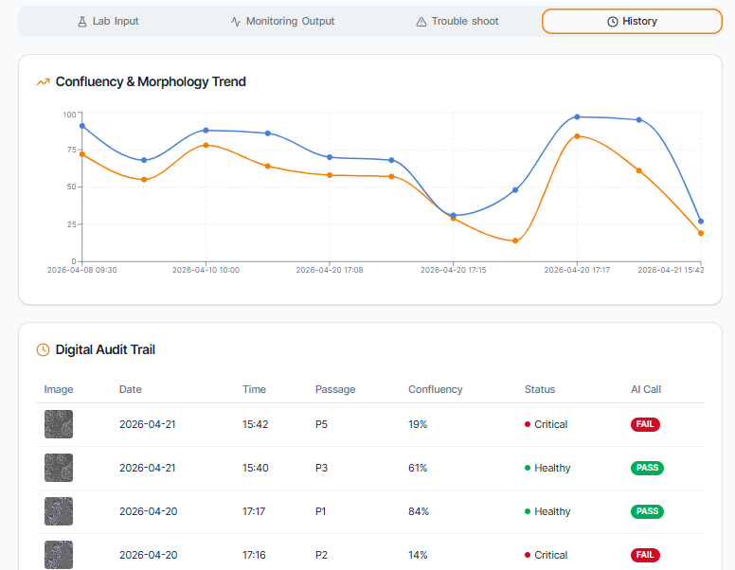
Tracking information

Slide 11
VALUE PROPOSITIONS
24/7 Autonomous Monitoring
Less Manual Work
Continuous AI-driven surveillance of iPSC cultures with no researcher downtime required.
Drastically reduces hours spent on manual monitoring, freeing researchers for high-value scientific work.
01
05
Instant Mobile Alerts
Stage Troubleshooting
Real-time push notifications sent directly to researcher phones the moment anomalies are detected.
AI-guided diagnostics pinpoint differentiation stage issues early before they cascade into loss.
02
06
Objective Morphology Scoring
Eliminates Overnight Batch Loss
Eliminates subjective human assessment, delivering consistent and reproducible quality scores at scale.
Catches critical culture failures during unstaffed hours, preventing costly and time-consuming batch restarts.
03
07
Digital Audit Trail
CORE MISSION
Full traceability and compliance documentation generated automatically for every culture event.
Empower iPSC researchers with AI-powered 24/7 quality monitoring that eliminates human error, reduces costs, and accelerates cell therapy development.
04

Slide 12
Initial system feedback:
Feature | Current State (MVP) | Future State
Analysis | Reactive (based on images) | Predictive (time-based simulations) The system will utilize to forecast culture.
Cell Variety | iPSC-focused | Multi-Line (MSCs, Primary cells, etc.)
Hardware | Requires continuous visual input | Virtual Monitoring (Software-only prediction)
Accuracy | Subjective/Learning | High-Precision (via researcher feedback loop, personlized)

Slide 13
Market Opportunity
Segment | Definition | Estimated Market Size (2024-2025)
TAM (Total Addressable Market) | Global Induced Pluripotent Stem Cell (iPSC) Market. the total global demand for iPSC technologies, including clinical and research applications. | $1.7B – $2.0B
SAM (Serviceable Addressable Market) | Regenerative Medicine & Cell Culture Monitoring Tools. This focuses on the specific sub-sector of researchers and companies that use automated monitoring and analysis tools | $13.8B – $25.7B
SOM (Serviceable Obtainable Market) | Academic & Mid-Size Biotech iPSC Core Facilities. Early Adopter market. Targeting the ~1,500 specialized iPSC labs globally. | $15M – $35M
https://www.biospace.com
https://straitsresearch.com
https://www.towardshealthcare.com

Slide 14
The Business Model
Designed for:
Designed by:
Date:
Version:
CellGuard AI
Zinab Idris
2026–2028
MVP 1.0
Key Partnerships
Key Activities
Customer Relationships
Customer Segments
model training
hardware integration
dashboard development
Researcher training
Regulatory prep
lab onboarding
Researcher training
Continuous SaaS updates
AI model personalisation
In-app troubleshoot
Payback Period: < 1 Month Net Annual Value: $117,700 per lab Labor Efficiency Gain: 16 hours/week per researcher Cost vs. Risk: The annual cost ($7.3k).
iPSC core labs
Biotech & pharma orgs
Cloud providers
Sensors & camera
STEMCELL Technologies
hospital research nets
FDA regulatory consultants
Academic iPSC core facilities
biotech cell therapy
pharma R&D departments
Research Orgs
research labs
Hospital translational research
Key Resources
Channels
iPSC morphology AI models
Edge hardware kits
cloud AI backend
Curated iPSC dataset
Lab partnership
Direct sales to lab
Biotech conferences
Academic publication network
LinkedIn biotech community
Cost Structure
Revenue Streams
AI model development — 50%
Hardware Integration Support — 10%
Cloud AI inference & storage — 15%
Sales, marketing & conferences — 18%
legal & regulatory — 7%
Implementation & Integration Fee ($1,500 - $3,000).
subscription (recurring): $200–$500 / lab / month
Enterprise (annual): $15K–$50K / year
Professional services: $5K–$20K per project

Slide 15






The Future of iPSC Culture
An AI Co-Scientist in Every Lab
Join our mission to automate precision cell therapy.
Phase 1
Phase 2
Phase 3
Phase 4
MVP Launch
research lab network
Beta Testing
Commercial Full Release
FDA Regulatory Mark

